Slide 1

A Citizens‘ Initiative to give the Earth Rights
End Ecocide in Europe
www.endecocide.eu

Slide 2
AGENDA
What is a European Citizens‘ Initiative?
Why using an ECI instead of a normal petition?
End Ecocide in Europe
How to get involved
Questions

Slide 3

The European Citizens‘ Initiative
Foundation in the Treaty of Lisbon; in effect since April 2012
Direct democratic tool: EU citizens can propose EU legislation
1 million signatories from at least 7 different EU countries needed

Slide 4
Who can support an ECI?
EU nationals or residents old enough to vote (some EU nationals excluded, e.g. UK nationals residing in some other EU countries)
Data requirements for signing the ECI varies, some MS require a passport or ID number
You can find further information on these two requirements here, http://ec.europa.eu/citizens-initiative/public/how-to-signup
Sign online or on paper
Minimum number of votes needed per country, Find further information here

Slide 5
What happens when we reach 1 million signatures?
European Commission to carefully examine the ECI
Public hearing in the European Parliament
Formal response by the Commission outlining which (if any) actions it will take
The EC is not obliged to propose legislation even if the ECI fulfils all requirements

Slide 6
Why a European Citizens‘ Initiative?
Legal power: citizen can propose legal acts
The ECI is addressed to the European Commission which has the duty to respond
Direct democracy
European spirit
Test tools given to us citizens
Exercise your legal right to vote

Slide 7
End Ecocide in Europe
Prohibit ecocide in 5 cases:
Ecocide committed on EU territory; or
Ecocide committed by EU citizens; or
Ecocide committed by EU registered companies, even when operating outside the EU; or
The import of products resulting from activities causing ecocide into the EU; or
The financial investment by EU banks and other financial institutions into activities causing ecocide, no matter where these activities take place

Slide 8
EEE – The Facts
Group of spirited Europeans
Signature collection started January 22, 2013: 10 more months to go!!
Learning by doing
Go beyond your frontiers
Become – Be - Best

Slide 9
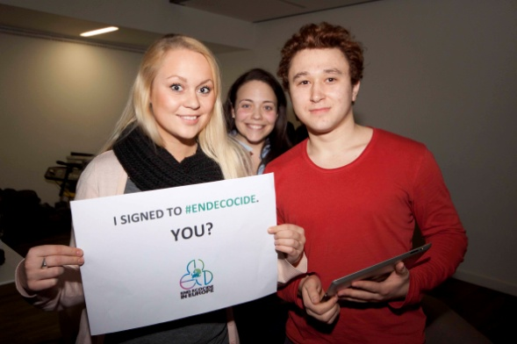
What YOU can do
Sign and spread the word
Volunteer with us
Join one of our country teams
Organise events
Write about us
Use your creativity
Your chance to contribute to making a difference

Slide 10
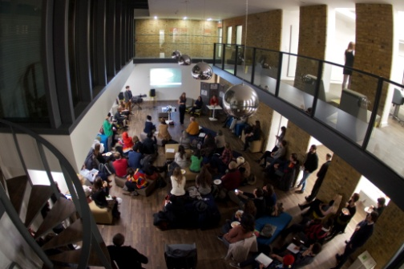
Promoting End Ecocide locally
Local action days
Your own event on End Ecocide
Collect signatures at your university
Use your creativity
How we help you
Materials
Advice
Speakers

Slide 11
"Never doubt that a small group of thoughtful, committed people can change the world.
Indeed, it is the only thing that ever has.“ (Margaret Mead)
You can be part of that change!
Questions? Ask me now or write to prisca@endecocide.eu
Want to volunteer? Contact ramon@endecocide.eu

